Slide 1
Communicating with Data – Welcome!
Dr. Ab Mosca (they/them)
Slides based off slides courtesy of Jordan Crouser (https://jcrouser.github.io/)

Slide 2
Plan for Today
Intros
About this course
How is visualization useful?
What is data?
Structure of this course

Slide 3



Who Am I?

Slide 4


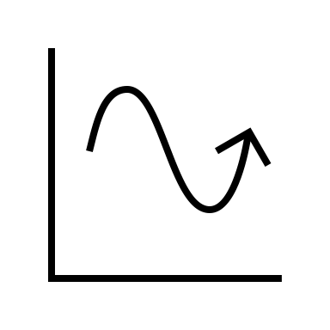
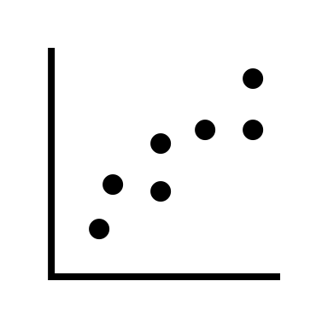

Who Am I?
Dr.

Slide 5



Who Am I?
Dr.

Slide 6
Who Are You?
Form groups of 3
Introduce yourselves (name, pronouns)
Share:
A highlight of your winter break
Find 1 thing that your entire group has in common (favorite color? hometown? left-handed? Be creative!)
After about 5 minutes we will go around, introduce ourselves, and share what each group has in common

Slide 7
Who Are You?
Form new groups of 3 (move around!)
Introduce yourselves (name, pronouns)
Share:
Would you rather live in an estate that can have anything you want but you can never leave OR live in a camper van and have to move every day?
After about 5 minutes we will go around, introduce ourselves, and share our would you rather answers

Slide 8
Who Are You?
Form new new groups of 3 (move around!)
Introduce yourselves (name, pronouns)
Debate:
Is cereal cold soup?
After about 5 minutes we will go around, introduce ourselves, and share our would you rather answers

Slide 9
Name tags!

Slide 10
About this course
Communicating with data

Slide 11


About this course
Communicating with data

Slide 12
About this course
What are the strengths of each wrt data and communication?
Communicating with data

Slide 13


About this course
What are the strengths of each wrt data and communication?
Communicating with data

Slide 14
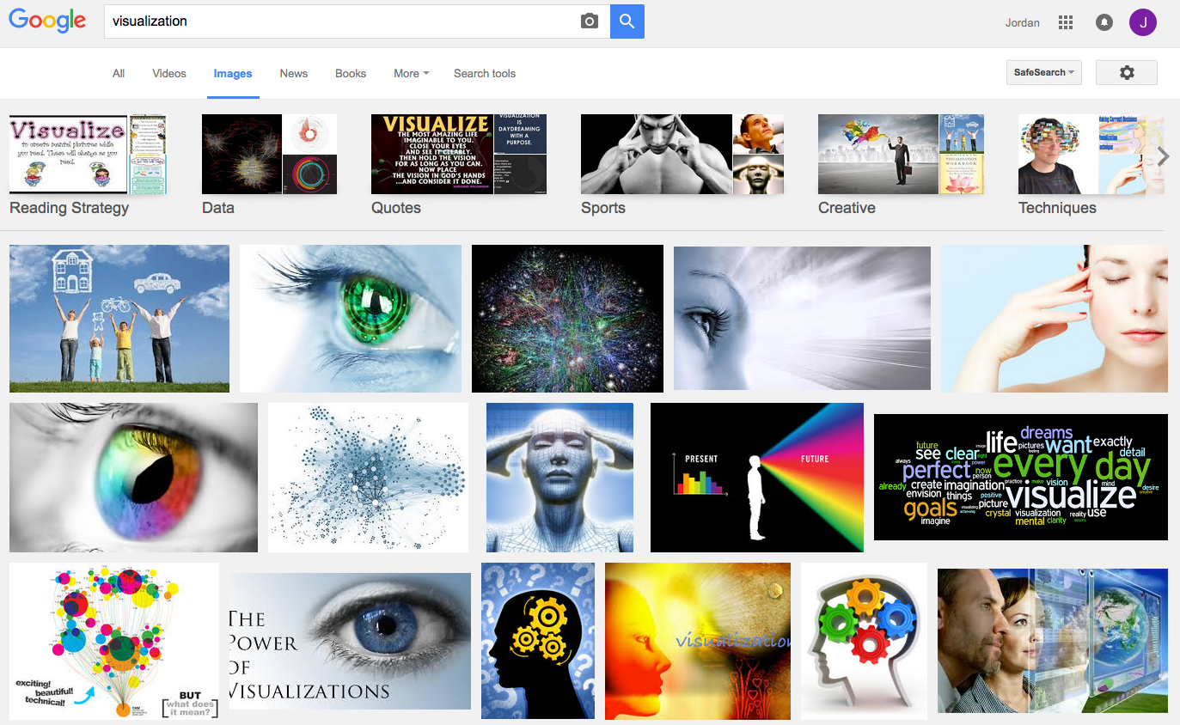
What is visualization?

Slide 15
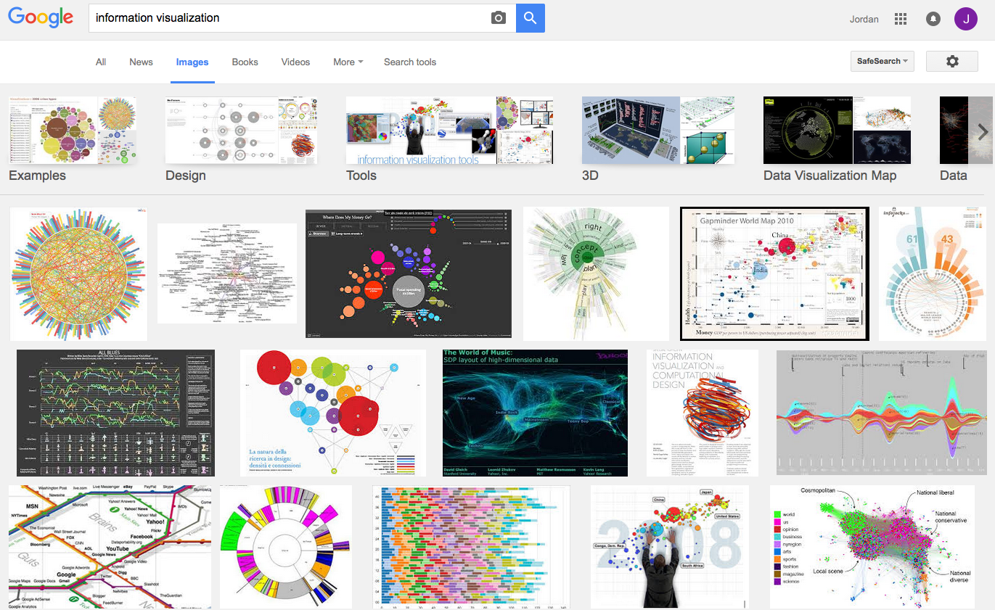
What is visualization?

Slide 16
Perhaps a more helpful question:
What are some ways
a “visualization” can be useful?

Slide 17
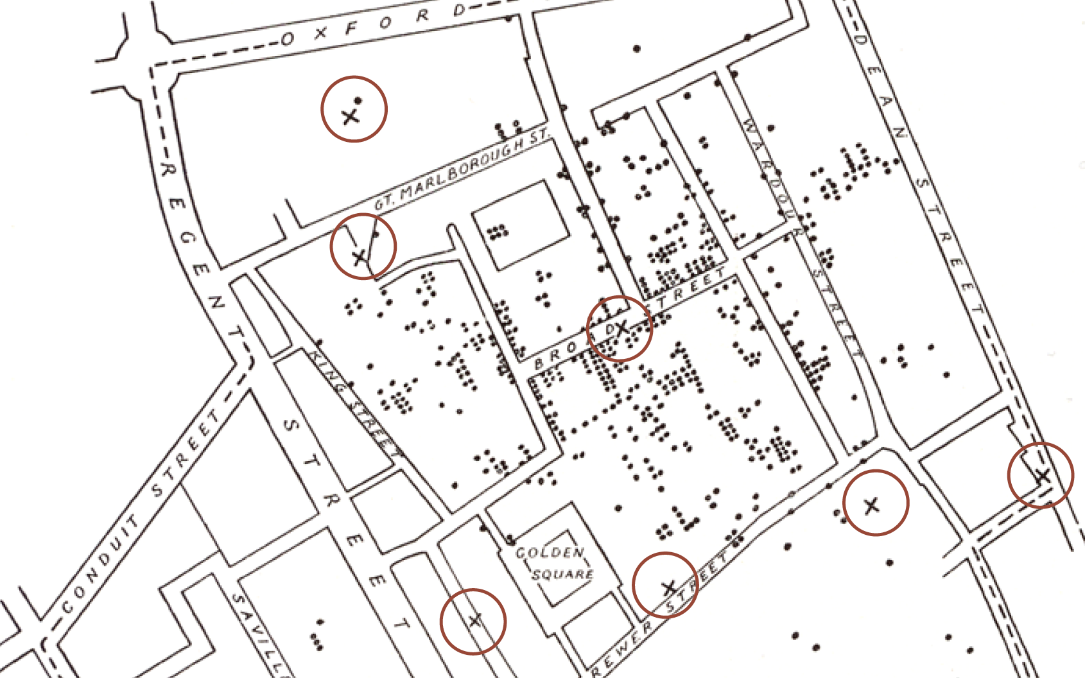
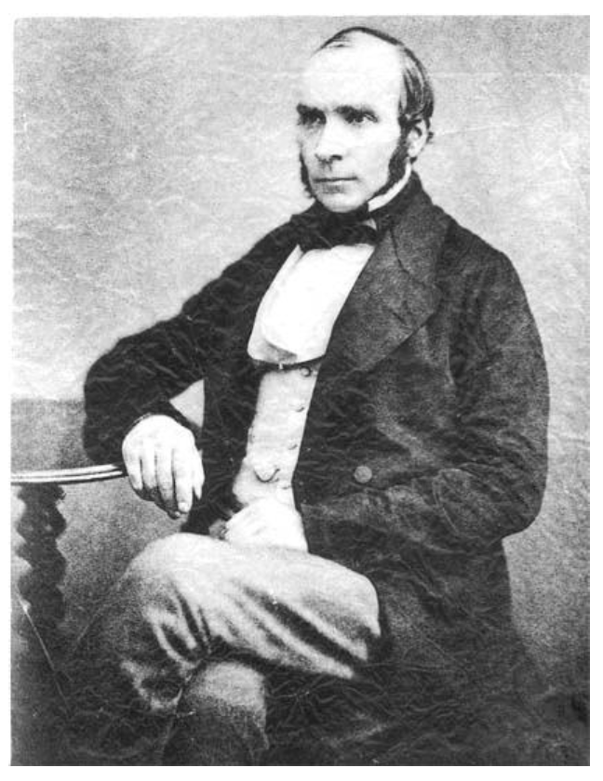
Does it help you spot trends?
In 1854, cholera broke out in London
127 people near Broad St. died within 3 days
616 people died within 30 days
Initial explanation:
“Miasma in the atmosphere”
Dr. John Snow was the first to link the outbreak to contaminated water
How did he do it?
Talked to local residents
Identified a water pump as a likely source
Used maps to illustrate his theory
Convinced authorities to disable the pump
More info here: http://en.wikipedia.org/wiki/1854_Broad_Street_cholera_outbreak

Slide 18
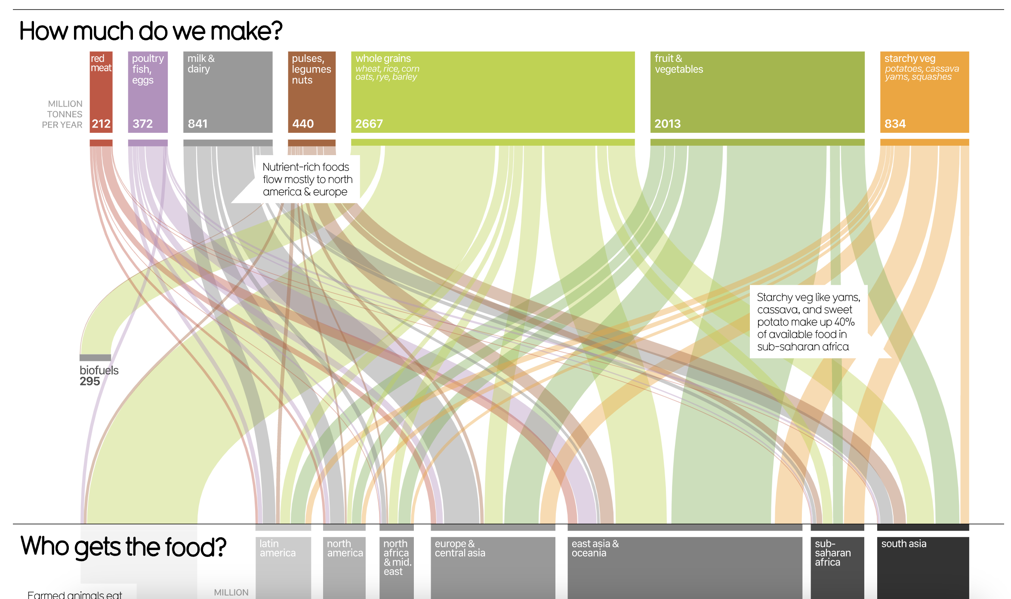
Does it help you explore?
https://informationisbeautiful.net/visualizations/global-food-supply-where-does-all-the-worlds-food-go/

Slide 19
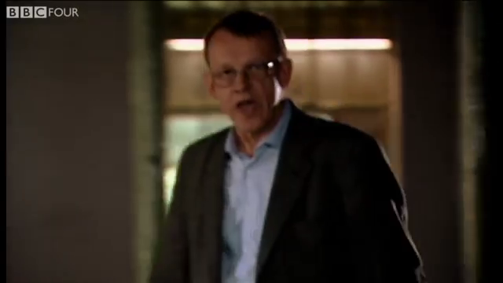
Does it tell a story?
Hans Rosling’s 200 Countries, 200 Years, 4 Minutes – The Joy of Stats – BBC Four
https://www.youtube.com/watch?v=jbkSRLYSojo

Slide 20
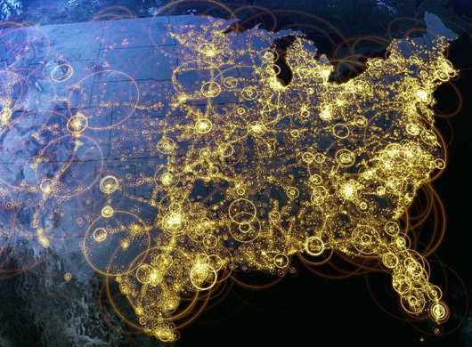
Visualization (def.)
Visual representations of data that reinforce human cognition
Notes:
Image from StackOverflow: http://i.stack.imgur.com/hbO8v.jpg

Slide 21

Wait… what is “data”?

Slide 22

Data: a definition
Data is a set of variables that capture various aspects of the world:
Tuition rates,
enrollment numbers,
public vs. private, etc.

Slide 23

Data: a definition
A dataset also contains a set of observations (also called records) over these variables. For example:
tuition = $46,288,
enrollment = 2,563,
private, etc.

Slide 24
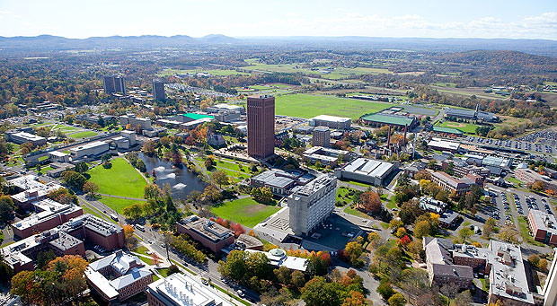

A dataset also contains a set of observations (also called records) over these variables. For example:
Data: a definition
tuition = $16,115,
enrollment = 28,635,
public, etc.

Slide 25
One way to think about this:
Also called: Attributes, Dimensions
VARIABLES
 | Tuition | Enrollment | Public vs. Private | …
Smith College | $46,288 | 2,563 | private
UMass Amherst | $16,115 | 28,635 | public
Hampshire College | $48,065 | 1,400 | private
Mount Holyoke College | $43,886 | 2,189 | private
Amherst College | $50,562 | 1,792 | private
⋮
OBSERVATIONS

Slide 26

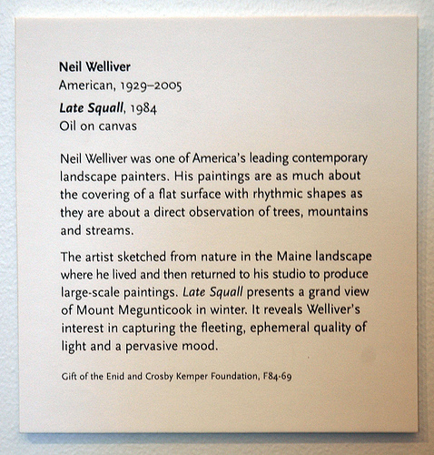
Another way to think about this
Information about the artist:
Name, place/date of birth,
date of death (if deceased)
Information about the piece:
Title, date, medium
Information about the donation:
Name of donor, reference number
Curated description and
relevant contextual information
Kinds of information = variables
Actual text on the placard = observations

Slide 27
Data: a definition
Each variable may be either independent or dependent:
An independent variable is not controlled or affected by another variable (e.g., time in a time-series dataset)
A dependent variable is affected by a variation in one or more associated independent variables (e.g., temperature in a region)

Slide 28
Basic data types
Nominal
Ordinal
Scale / Quantitative
Ratio
Interval
An unordered set {…}
of non-numeric values
For example:
Categorical (finite) data
{apple, orange, pear}
{red, green, blue}
Arbitrary (infinite) data
{“12 Main St. Boston MA”, “45 Wall St. New York NY”, …}
{“John Smith”, “Jane Doe”, …}

Slide 29
Basic data types
Nominal
Ordinal
Scale / Quantitative
Ratio
Interval
An ordered set <…>
(also known as a tuple)
For example:
Numeric: <2, 4, 6, 8>
Binary: <0, 1>
Non-numeric:
<G, PG, PG-13, R>

Slide 30
Nominal
Ordinal
Scale / Quantitative
Ratio
Interval
A numeric range […]
Ratios
Distance from “absolute zero”
Can be compared mathematically using division
For example: height, weight
Intervals
Ordered numeric elements that can be mathematically manipulated, but cannot be compared as ratios
E.g.: date, current time
Basic data types

Slide 31
Converting between basic data types
Q → O [0, 100] → <F, D, C, B, A>
O → N <F, D, C, B, A> → {C, B, F, D, A}
N → O (??)
{John, Mike, Bob} → <Bob, John, Mike> ??
{red, green, blue} → <blue, green, red> ??
N → Q (??)
Bob + John = ??
Readings in Information Visualization: Using Vision To Think. Card, Mackinglay, Schneiderman, 1999

Slide 32
Basic operations
Nominal (N)
Equality: = and ≠
Frequency: how often does x appear?
Ordinal (O)
Relation to other points: >, <, ≥, ≤
Distribution: relative frequency
Quantitative (Q)
Other mathematical operations: (+, -, *, /, etc.)
Descriptive statistics: average, standard deviation, etc.

Slide 33
Why is this important?
Data have dimensions
Visualizations have dimensions, too
To build visualizations, we need to map data dimensions to visual dimensions
Like what?

Slide 34
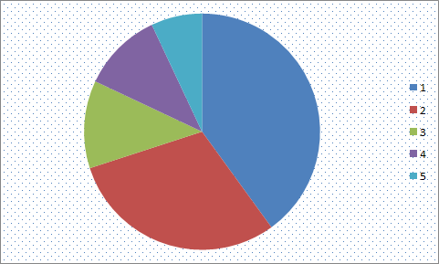
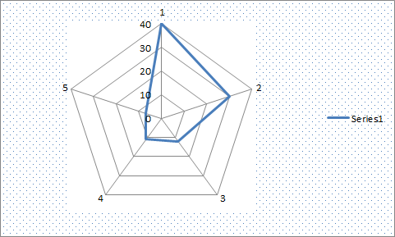
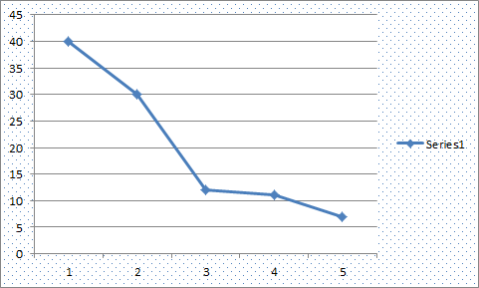
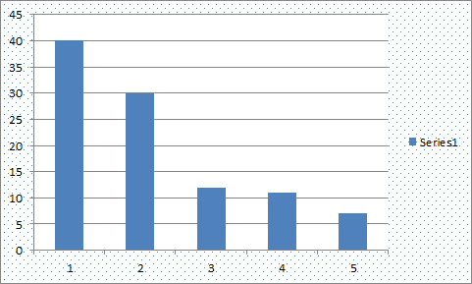
Key question for this course
Which data dimension should be mapped
to which visual dimension?

Slide 35
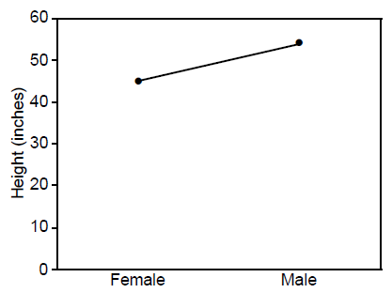
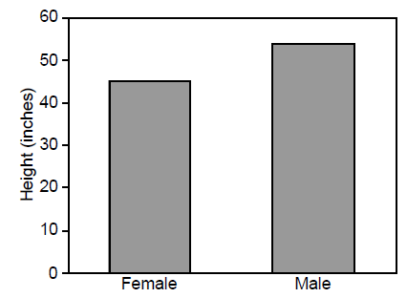
Answer: it depends
Average Height for Youth Sports Participants
Gymnastics Basketball
Gymnastics Basketball

Slide 36
What we’ll cover in this class
Introduction to data
Data-visual mapping
Introduction to perception
Tableau
User-centered design

Slide 37
What we will not cover in this class
Introduction to coding
Introduction to statistics
Data wrangling
Advanced visualization theory (take 235 for this!)

Slide 38
General information
Course website:
https://amosca01.github.io/SDS-CS109/
Syllabus
Slides
Schedule
Assignments
Links

Slide 39
General information
Time Management:
Smith college guidelines suggest 3 hours of work per credit per week. This is a 4 credit course, so you should expect to spend 12 hours on it per week:
2.5 hours in class
1-2 hours preparing for class
7.5-8.5 hours on homework and outside study
The purpose of class time is to introduce and explore new topics. To complete assignments, you will often need to look up, learn, and practice material that extends beyond that covered during class meeting times.

Slide 40
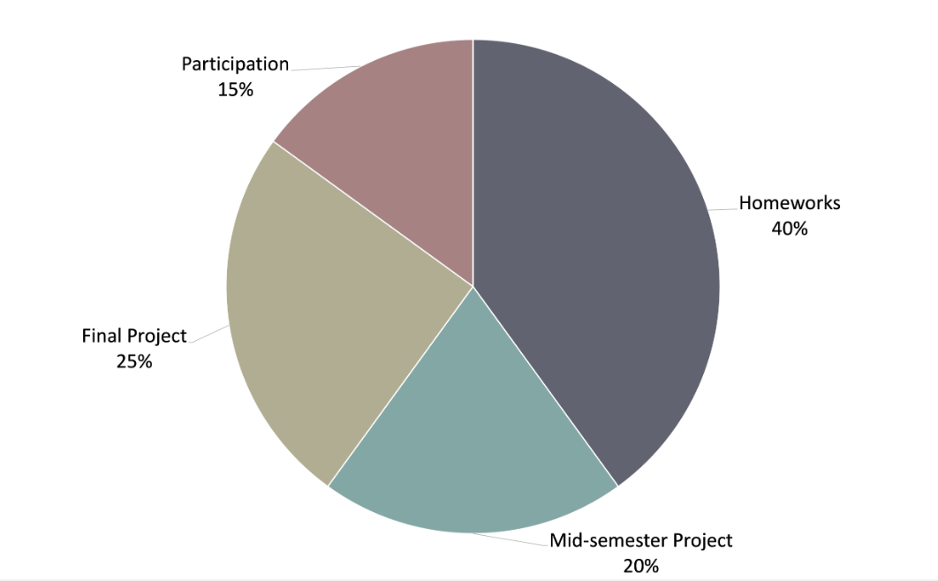
General information
Assessment:

Slide 41
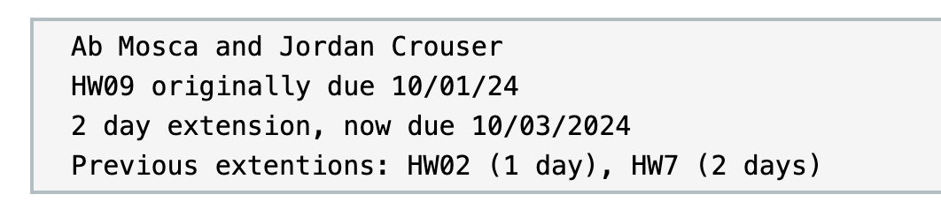
General information
Late Policy:
We develop skills through practice, and assignments build on one another AND life happens.
You have unlimited extensions in this class
Extensions must be requested before assignment due date
For an extension, submit a file with:
Your name (and group members' names)
Assignment number and original due date
Duration of extension and new due date
Review of any prior extension requests
Ex.
Late work receives lowest priority for grading

Slide 42
General information
Revise and Resubmit:
We develop skills through repeated practice and learn from mistakes.
You have unlimited revise and resubmits in this class
You cannot revise and resubmit an assignment that was not turned in
Your resubmission must include a changelog
Highest grade will prevail
Resubmitted work receives lowest priority for grading

Slide 43
General information
Comfy Classroom:
Need to stand up and leave for a minutes? Do it.
Want to sit somewhere other than a chair? Go for it.
Have a concentration aid? Use it.
Hungry? Thirsty? Eat and drink (be careful of spills!).
Have kids and no childcare? Bring your kids.
Do what you need to do to learn, just be respectful of other learners.

Slide 44
What you’ll get
By the end of this course, you will:
Know how to use visualization to communicate ideas
Know the foundational methods and tools available
Be familiar with ongoing research in visualization
Have (marketable!) experience developing useful visualizations to solve real problems

Slide 45
What I expect from you
You like challenging problems, and you’re excited about “figuring stuff out”
You’re willing to get comfortable asking questions
You’re interested in the perspectives of people with very different backgrounds from your own
You turn things in on time, show up to class, or let me know in advance

Slide 46
What you can expect from me
I’m flexible w.r.t. the topics we cover:
This course is a collaboration
If there’s something you want to learn that’s not on the agenda, speak up!
If I’m doing something that doesn’t work for you (Font too small on presentations? Speaking too quickly? Using a marker or color you can’t see?), please let me know!
I’m here to help you succeed, and I believe you all have the ability to succeed

Slide 47
Questions?

